Slide 1

Counting the number of reads per annotated gene
Quantify the number of reads mapping to the exons of each gene.
Estimation of Strandness
Infer Experiment tool in Galaxy used to determine the library strandness
Input – RNA STAR file
Reference genome - Drosophila_melanogaster.BDGP6.87.gtf (BED12 file)
GSM461177 – Untreated sample
From the result 46.49% of the reads were assigned to the forward strand and 43.88% of the reads were assigned to the reverse strand. This indicated that the library was unstranded for the sample.

Slide 2

GSM461180 – Treated sample
From the result 45.24% of the reads were assigned to the forward strand and 45.38% of the reads were assigned to the reverse strand. This indicated that the library was unstranded for the sample.
Counting reads per genes
Galaxy tool FeatureCounts to count the number of reads per annotated gene.
File – RNA STAR output file
Annotated file - Drosophila_melanogaster.BDGP6.87.gtf
MultiQC to aggregate the results
Input file – Output of FeatureCounts
SAMPLE | Percent Assigned reads | No. of reads of assigned (Millions)
GSM461177 | 63% | 8.2
GSM461180 | 62.8% | 8.4

Slide 3
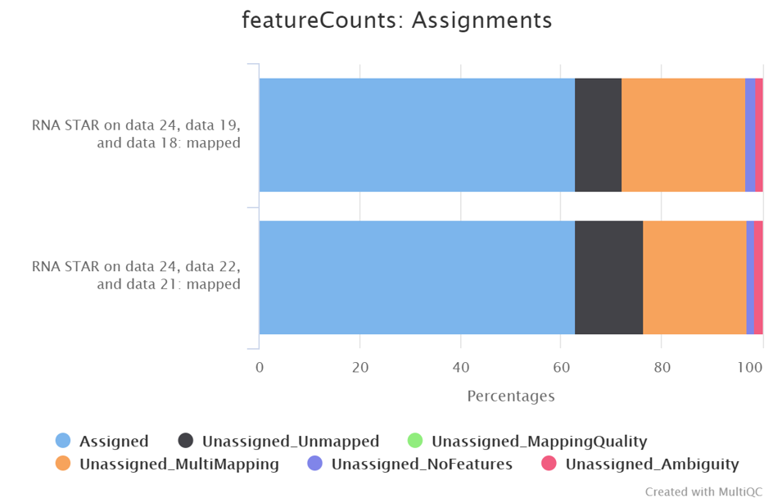
GSM461177
GSM461180

Slide 4
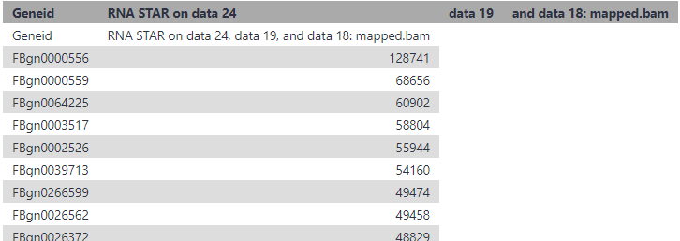
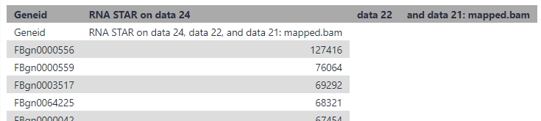
To determine most feature count in two sample
Sort galaxy tool in descending order
Input files – Output feature counts
GSM461177
GSM461180
FBgn0000556 id the feature with most counts in both sample with 128741 counts in untreated and 127416 counts in treated

